Slide 1


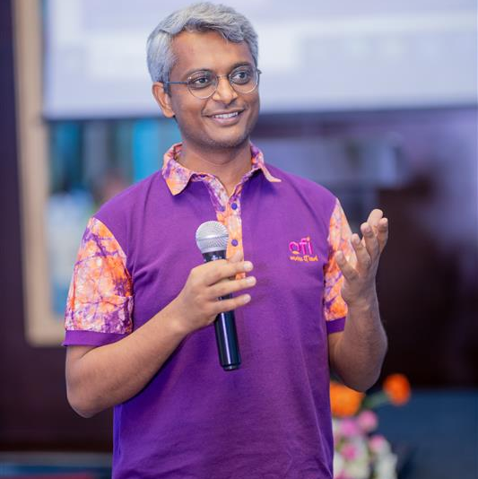
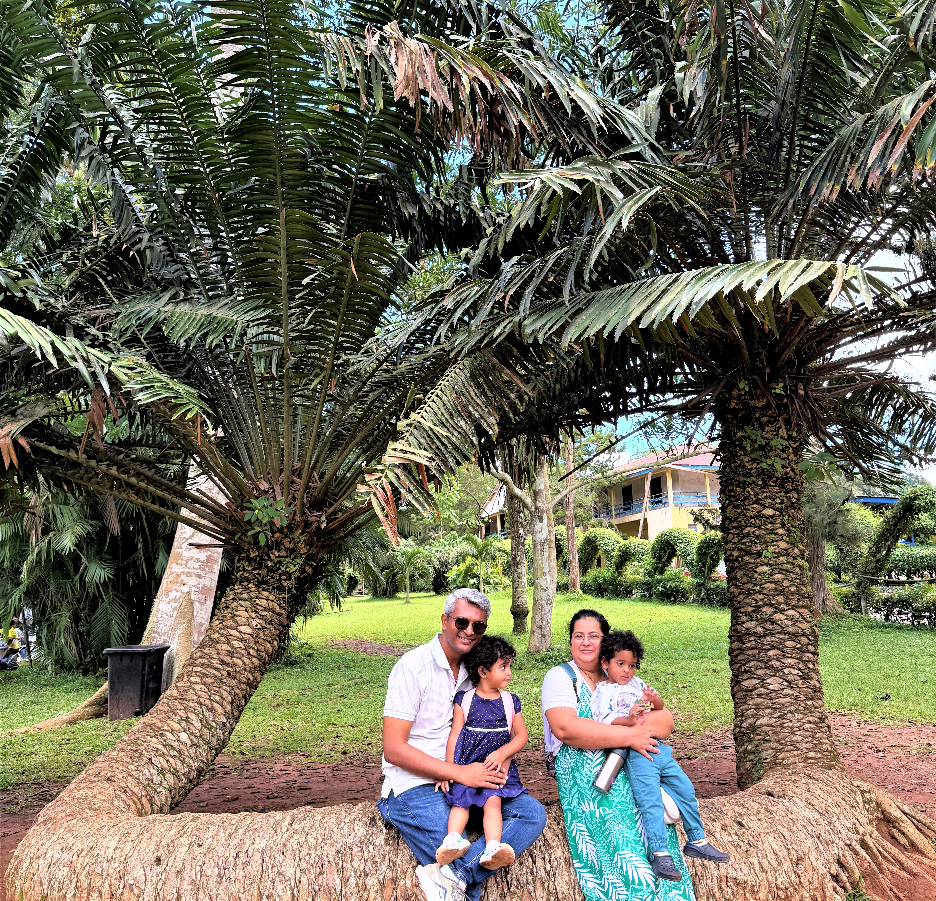
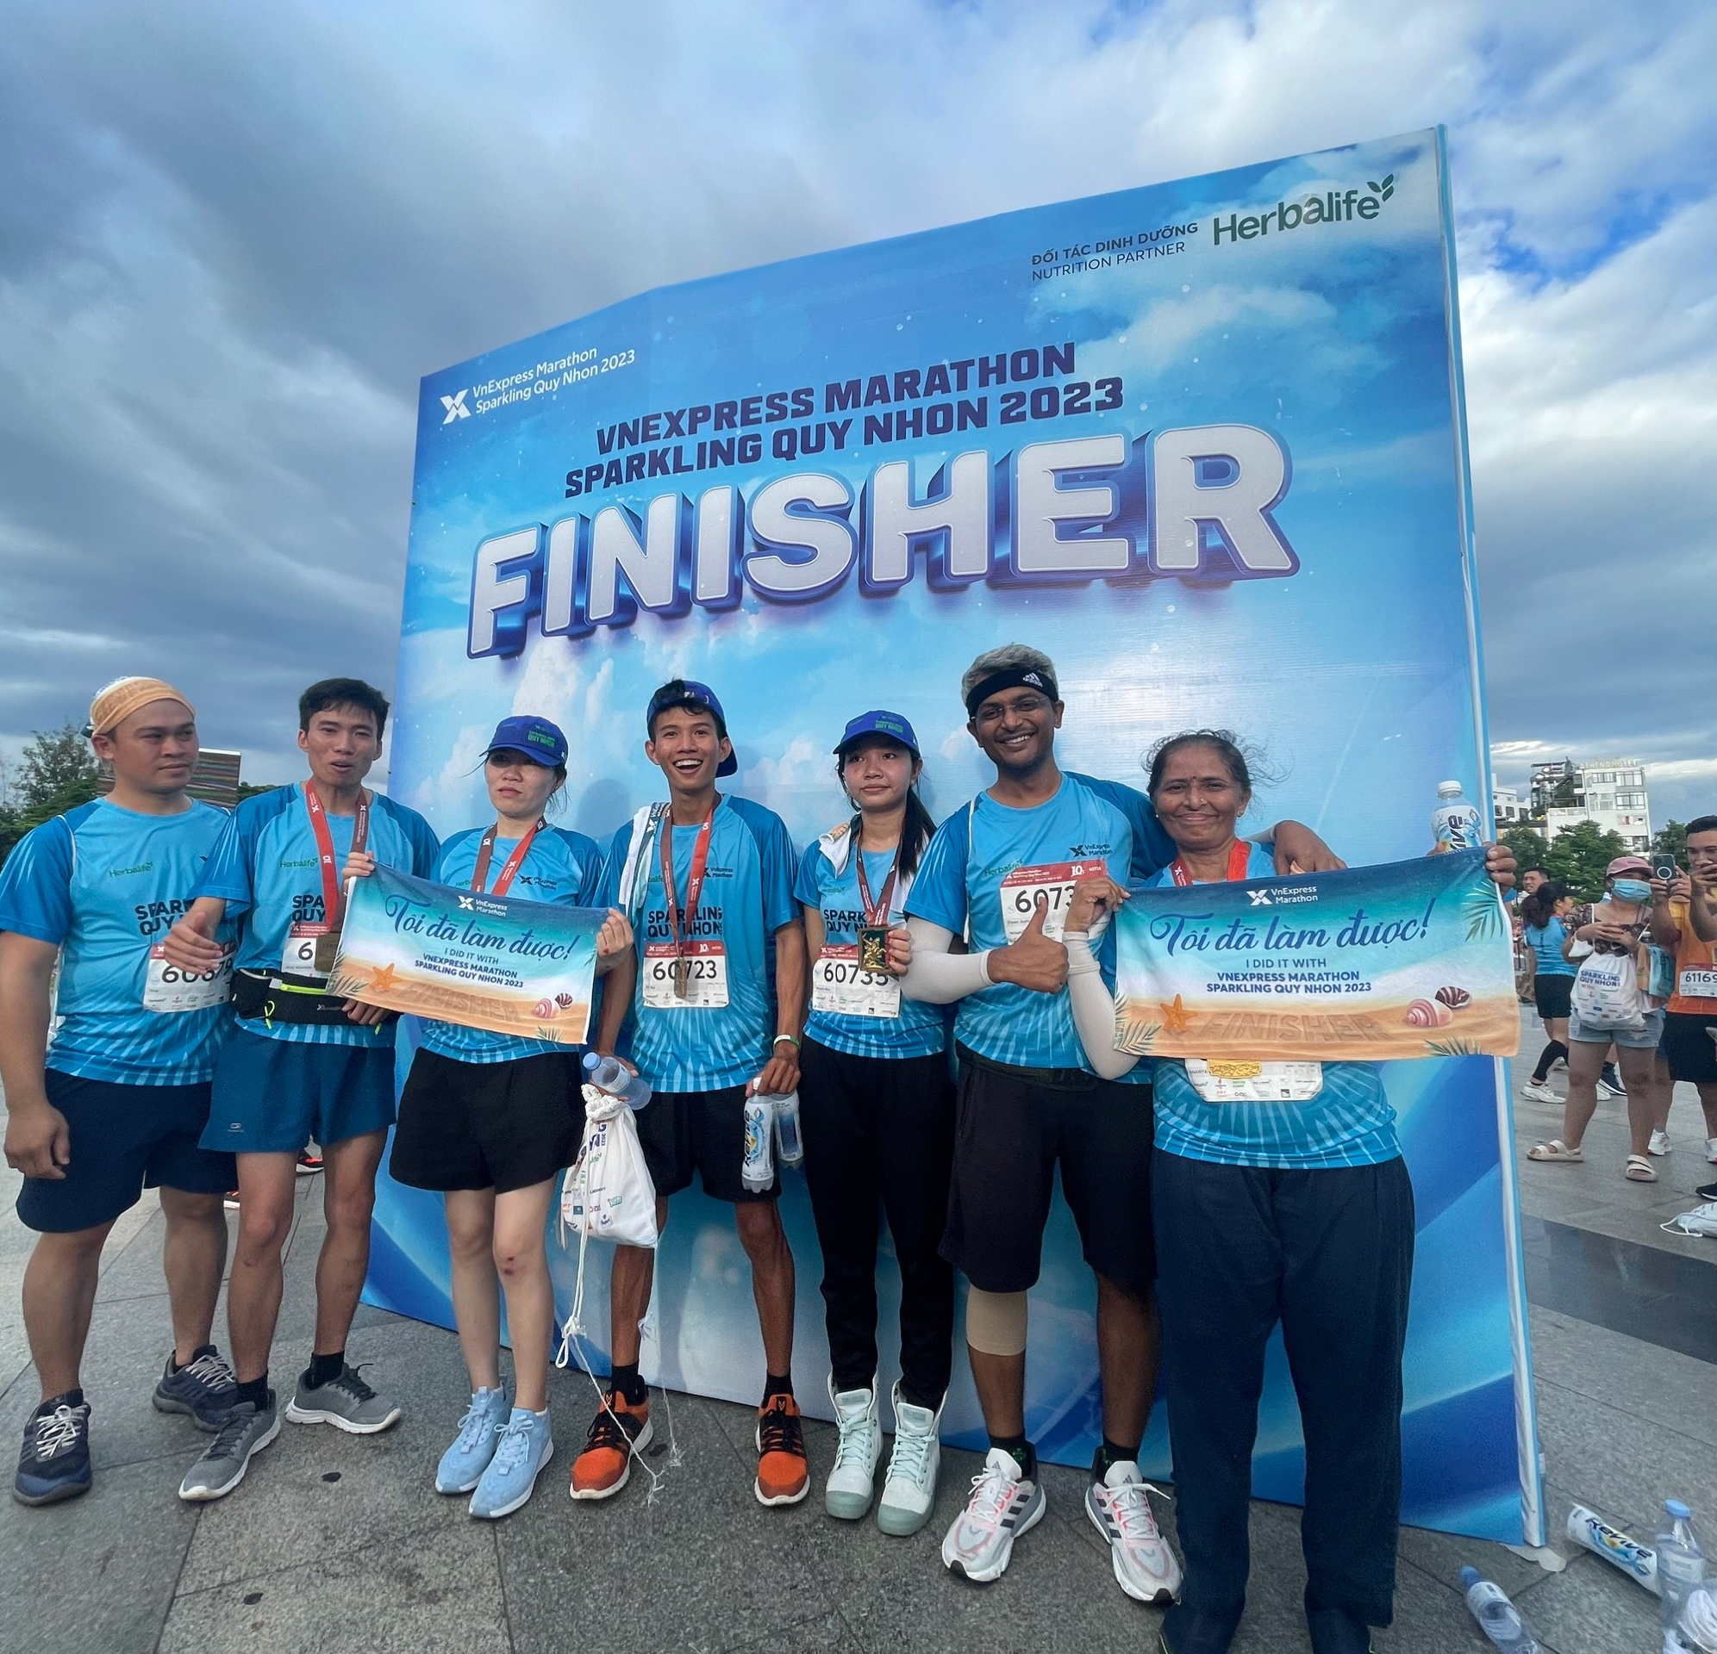
Getting to Know Me
Work
Personal
My role
Profit Center Head – Ghana & Burkina
Significant others / family members / furry friends in my life
Riddhi, my wife; my twins – Maddy & Manu
Tenure in ofi/Olam
7 years
How I enjoy spending my free time
Being with my people
Previous companies I have worked at
ITC Ltd and Amul
My favorite / comfort food
Waghareli Khichdi (rice based dish)
Why I joined ofi/Olam and what keeps me here?
Joined as I was getting posted in my home location (that phase lasted 0.5 years). What keeps me here is exceptional quality of my colleagues.
My favorite song
Kabira from Yeh Jawani Hai Deewani movie
Dipen Joshi
‘Dipen’
A few fun facts about me
Sarcasm is my favorite language!
Curious and adaptable by nature.
This is me outside work, doing stuff I enjoy in my life …

